Slide 1
Error Control

Slide 2
Error Control
Positive and Negative feedback
Timers : what happens when a frame completely vanishes : receiver neither sends a +ack nor –ack … then timer comes to help.
  It may result in a frame being sent more than once and received more than once :
  solution : assign sequence numbers to frames

Slide 3
Error Detection and Correction
In some cases it is sufficient to detect an error and in some, it requires the errors to be corrected also. For eg.
  On a reliable medium : ED is sufficient where the error rate is low and asking for retransmission after ED would work efficiently
  In contrast, on an unreliable medium : Retransmission after ED may result in another error and still another and so on. Hence EC is desirable.

Slide 4
Error Detection and Correction
Networks must be able to transfer data from one device to another with complete accuracy.
Data can be corrupted during transmission.
For reliable communication, errors must be detected and corrected.
Error detection and correction are implemented either at the data link layer or the transport layer of the OSI model.

Slide 5
Network designers have developed two basic strategies for dealing with errors. Both add redundant information to the data that is sent.
One strategy is to include enough redundant information to enable the receiver to deduce what the transmitted data must have been.
The other is to include only enough redundancy to allow the receiver to deduce that an error has occurred (but not which error) and have it request a retransmission.
The former strategy uses error-correcting codes and the latter uses error-detecting codes.
Use of error-correcting codes is called as Forward Error Correction

Slide 6
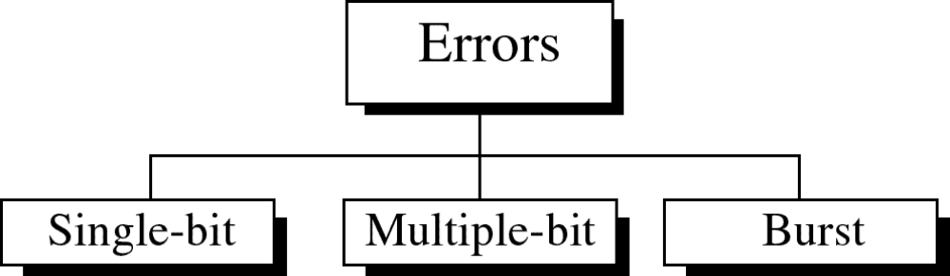
Types of Errors

Slide 7
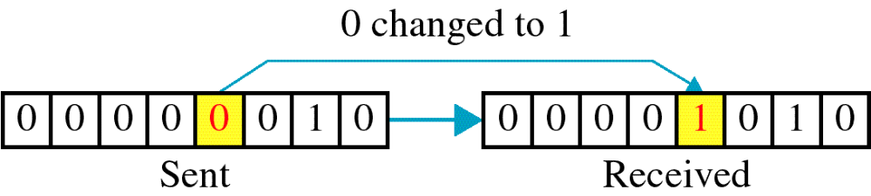
Single-bit error

Slide 8
Single bit errors are the least likely type of errors in serial data transmission because the noise must have a very short duration which is very rare. However this kind of errors can happen in parallel transmission.
Example:
If data is sent at 1Mbps then each bit lasts only 1/1,000,000 sec. or 1 μs.
For a single-bit error to occur, the noise must have a duration of only 1 μs, which is very rare.

Slide 9
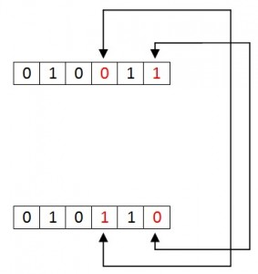
Multiple Bit Data Errors
If there is change in two or more bits of data sequence of transmitter to receiver, it is called “Multiple bit error”.
This type of error occurs in both serial type and parallel type data communication networks.

Slide 10
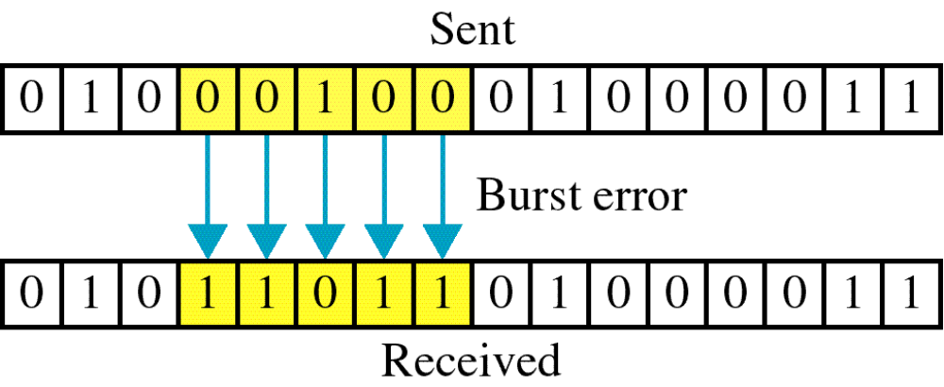
Burst error

Slide 11
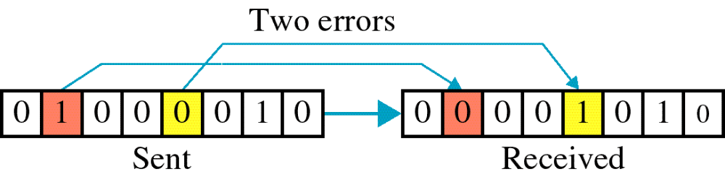

Slide 12
The term burst error means that two or more bits in the data unit have changed from 1 to 0 or from 0 to 1.
Burst errors does not necessarily mean that the errors occur in consecutive bits, the length of the burst is measured from the first corrupted bit to the last corrupted bit. Some bits in between may not have been corrupted.

Slide 13
Burst error is most likely to happen in serial transmission since the duration of noise is normally longer than the duration of a bit.
The number of bits affected depends on the data rate and duration of noise.
Example:
If data is sent at rate = 1Kbps then a noise of 1/100 sec can affect 10 bits.(1/100*1000)
If same data is sent at rate = 1Mbps then a noise of 1/100 sec can affect 10,000 bits.(1/100*10⁶)

Slide 14
Redundancy : is the central concept in detecting & correcting errors. We need to send some extra bits with our data.
These redundant bits are added by the sender and removed by the receiver .
To detect or correct errors, we need to send extra (redundant) bits with data.

Slide 15
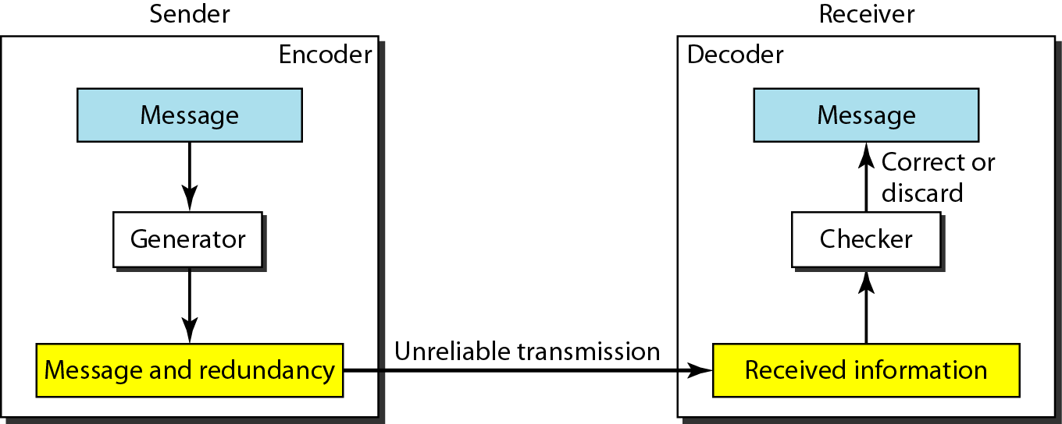
The structure of encoder and decoder

Slide 16
Detection Versus Correction
In error detection, we are looking only to see if any error has occurred. A single-bit error is the same for us as a burst error.
In error correction, we need to know the exact number of bits that are corrupted and more importantly, their location in the message. So the number of errors and the size of the message are important factors.
correction of errors is more difficult than the detection

Slide 17
Forward Error Correction Versus Retransmission
Tow main methods of error correction
Forward error correction FEC: is the process in which the receiver tries to guess the message by using redundant bits.
Retransmission: is a technique in which the receiver detects the occurrence of an error and asks the sender to resend the message.
FEC is used if the number of errors is small.

Slide 18
Coding
Redundancy is achieved through various coding schemes. The sender adds redundant bits through a process that creates a relationship between the redundant bits and the actual data bits.
The receiver checks the relationships between the two sets of bits to detect or correct the errors.
The ratio of redundant bits to the data bits and the robustness of the process are important factors in any coding scheme.

Slide 19
Coding schemes are divided into two categories :
1-block coding .
2-convolution coding.
convolution coding is more complex than block coding.

Slide 20
Modular Arithmetic
In modular arithmetic, we use only a limited range of integers. We define an upper limit, called a modulus N. We then use only the integers 0 to N -1.
For example, if the modulus is 12, we use only the integers 0 to 11.
In a modulo-N system, if a number is greater than N, it is divided by N and the remainder is the result.
Addition and subtraction in modulo arithmetic are simple. There is no carry when you add two digits in a column. There is no carry when you subtract one digit from another in a column

Slide 21
Modulo-2 Arithmetic
Of particular interest is Modulo-2arithmetic. In this arithmetic ,the modulus is 2. We can use only 0 and 1. Operations in this arithmetic are very simple. The following shows how we can add or subtract 2 bits.
Adding: 0+0=0 0+1=1 1+0=1 1+1=0
Subtracting: 0 -0=0 0 -1=1 1-0=1 1 -1=0
Use the XOR (exclusive OR) operation for both addition and subtraction.

Slide 22
BLOCK CODING
In block coding, we divide our message into blocks, each of k bits, called data words.
We add redundant bits to each block to make the length n = k + r. The resulting n-bit blocks are called code words.
With k bits, we can create a combination of 2^{k} data words; with n bits, we can create a combination of 2^{n} code words.
The block coding process is one-to-one; the same data word is always encoded as the same code word. This means that we have 2^{n} - 2^{k} code words that are not used.

Slide 23
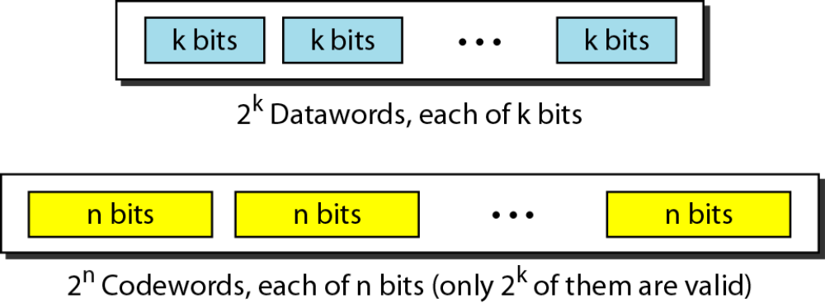
Data words and code words in block coding

Slide 24
Error Detection
How can errors be detected by using block coding? If the following two conditions are met, the receiver can detect a change in the original code word.
1. The receiver has (or can find) a list of valid code words.
2. The original code word has changed to an invalid one.
An error-detecting code can detect only the types of errors for which it is; designed, other types of errors may remain undetected.

Slide 25
Hamming Distance
One of the central concepts in coding for error control is the idea of the Hamming distance.
The Hamming distance can easily be found if we apply the XOR operation (Θ) on the two words and count the number of 1’sin the result. Note that the Hamming distance is a value greater than zero.
The Hamming distance between two words is the number of differences between corresponding bits.

Slide 26
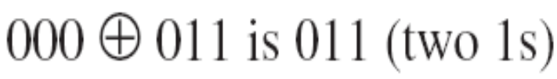
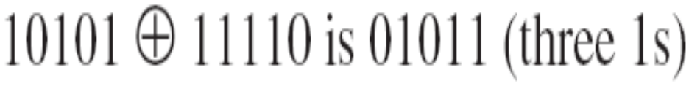
The Hamming distance d(000, 011) is 2 because
The Hamming distance d(10101, 11110) is 3 because

Slide 27
Minimum Hamming Distance –
the measurement that is used for designing a code is the minimum Hamming distance.
We used dmin to define the minimum Hamming distance in a coding scheme.
To find this value, we find the Hamming distances between all words and select the smallest one.
The minimum Hamming distance is the smallest Hamming distance between all possible pairs in a set of words.

Slide 28
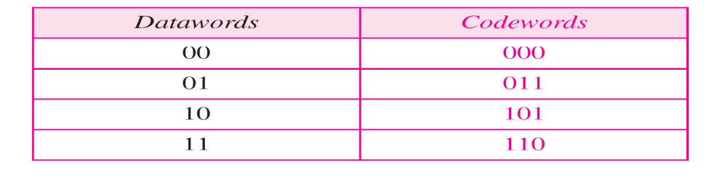
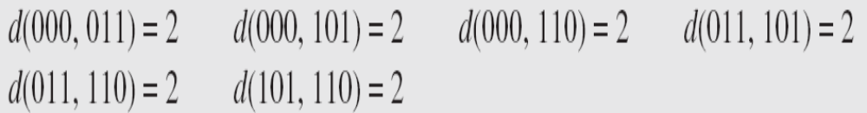
The dmin in this case is 2.

Slide 29
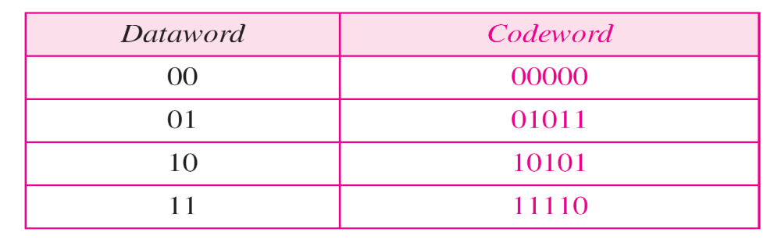
The dmin in this case is 3.

Slide 30
Three Parameters
Any coding scheme needs to have at least three parameters:
the code word size n, the data word size k, and the minimum Hamming distance dmin.
A coding scheme C is written as C(n, k) with a separate expression for dmin.
For example, we can call our first coding scheme C(3, 2) with dmin=2 and our second coding scheme C(5, 2) with dmin= 3.

Slide 31
Hamming Distance and Error
Relationship between the Hamming distance and errors occurring during transmission.
When a code word is corrupted during transmission, the Hamming distance between the sent and received code words is the number of bits affected by the error.
In other words, the Hamming distance between the received code word and the sent code word is the number of bits that are corrupted during transmission.
For example, if the code word 00000 is sent and 01101 is received, 3 bits are in error and the Hamming distance between the two is d(00000, 01101) =3.
To guarantee the detection of up to s errors in all cases, the minimum Hamming distance in a block code must be dmin= s + 1.

Slide 32
LINEAR BLOCK CODES
Almost all block codes used today belong to a subset called linear block codes. A linear block code is a code in which the exclusive OR (additionmodulo-2) of two valid code words creates another valid code word.
In a linear block code, the exclusive OR (XOR) of any two valid code words creates another valid code word.

Slide 33
Minimum Distance for Linear Block Codes
It is simple to find the minimum Hamming distance for a linear block code.
The minimum Hamming distance is the number of 1s in the nonzero valid code word with the smallest number of 1s.

Slide 34
Error Detection
Error detection is the ability to detect the presence of errors caused by noise or other impairments during transmission from the transmitter to the receiver.
Error detection means to decide whether the received data is correct or not without having a copy of the original message.
Error detection uses the concept of redundancy, which means adding extra bits for detecting errors at the destination.

Slide 35
Three different error-detecting codes. They are all linear, systematic block codes:
1. Parity.
2. Cyclic Redundancy Checks (CRCs).
3. Checksums.

Slide 36
Parity
The stream of data is broken up into blocks of bits, and the number of 1 bits is counted. Then, a "parity bit" is set (or cleared) if the number of one bits is odd (or even).
The parity bit is chosen so that the number of 1 bits in the codeword is even (or odd).
Doing this is equivalent to computing the (even) parity bit as the modulo 2 sum or XOR of the data bits.
For example, when 1011010 is sent in even parity, a bit is added to the end to make it 10110100. With odd parity 1011010 becomes 10110101.

Slide 37
A code with a single parity bit has a distance of 2, since any single-bit error produces a codeword with the wrong parity. This means that it can detect single-bit errors.
If the tested blocks overlap, then the parity bits can be used to isolate the error, and even correct it if the error affects a single bit.

Slide 38
A single parity bit can only reliably detect a single-bit error in the block. If the block is badly garbled by a long burst error, the probability that the error will be detected is only 0.5, which is hardly acceptable.
Solution :
Interleaving - compute the parity bits over the data in a different order than the order in which the data bits are transmitted.
We compute a parity bit for each of the n columns and send all the data bits as k rows, sending the rows from top to bottom and the bits in each row from left to right in the usual manner. At the last row, we send the n parity bits.

Slide 39
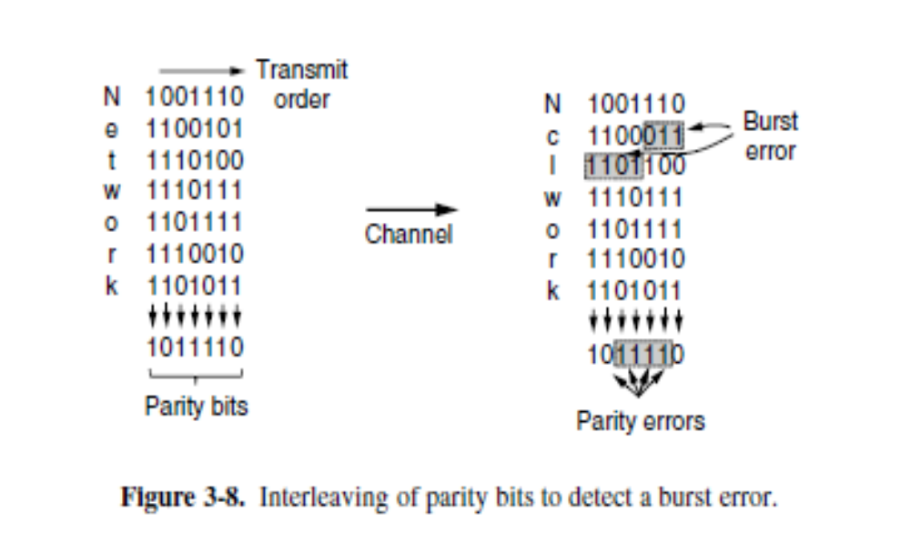

Slide 40
Simple Parity-Check Code: the most familiar error-detecting code is the simple parity-check code.
In this code, a k-bit data word is changed to an n-bit code word where n = k + 1. The extra bit, called the parity bit, is selected to make the total number of 1s in the code word even.
A simple parity-check code is a single-bit error-detecting code in which n = k + 1 with dmin= 2.

Slide 41
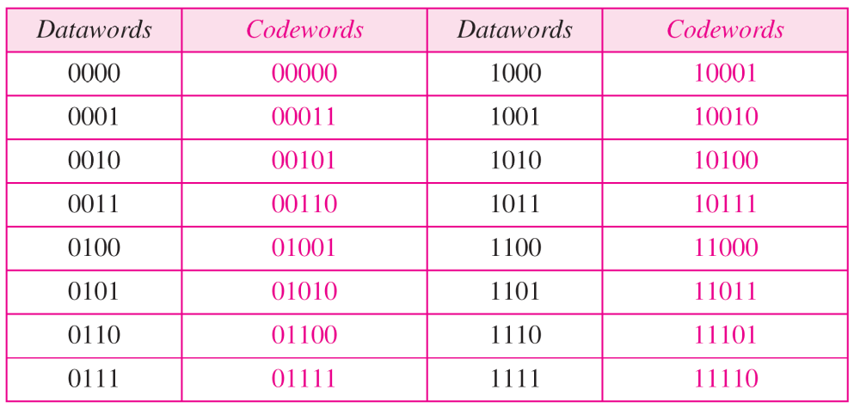
Simple parity-check code C(5, 4)

Slide 42
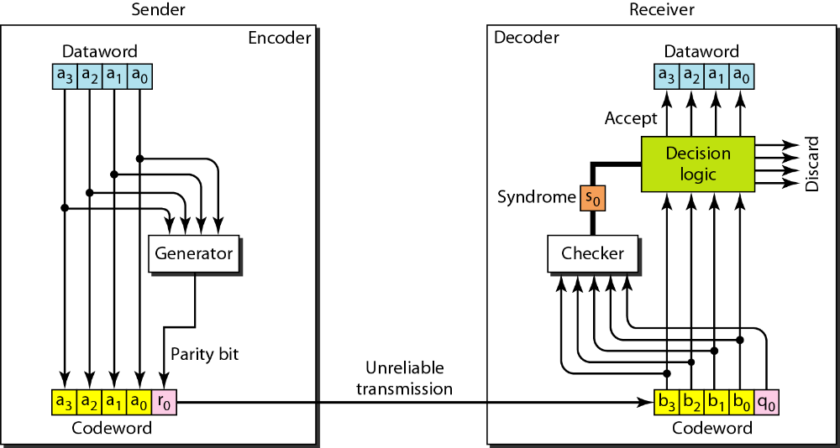
Encoder and decoder for simple parity-check code

Slide 43
Some transmission scenarios.
Assume the sender sends the data word 1011.
The code word created from this data word is 10111, which is sent to the receiver.
We examine five cases:
1.No error occurs; the received code word is 10111. The syndrome is 0. The data word 1011 is created.
2.One single-bit error changes a1. The received code word is 10011. The syndrome is 1. No data word is created.
3.One single-bit error changes r0. The received code word is 10110. The syndrome is 1. No data word is created.

Slide 44
4.An error changes r0 and a second error changes a3.
The received code word is 00110. The syndrome is 0.The data word 0011 is created at the receiver. Note that here the data word is wrongly created due to the syndrome value.
5. Three bits—a3, a2, and a1—are changed by errors. The received code word is (01011). The syndrome is 1.The data word is not created.
This shows that the simple parity check, guaranteed to detect one single error ,can also find any odd number of errors.

Slide 45
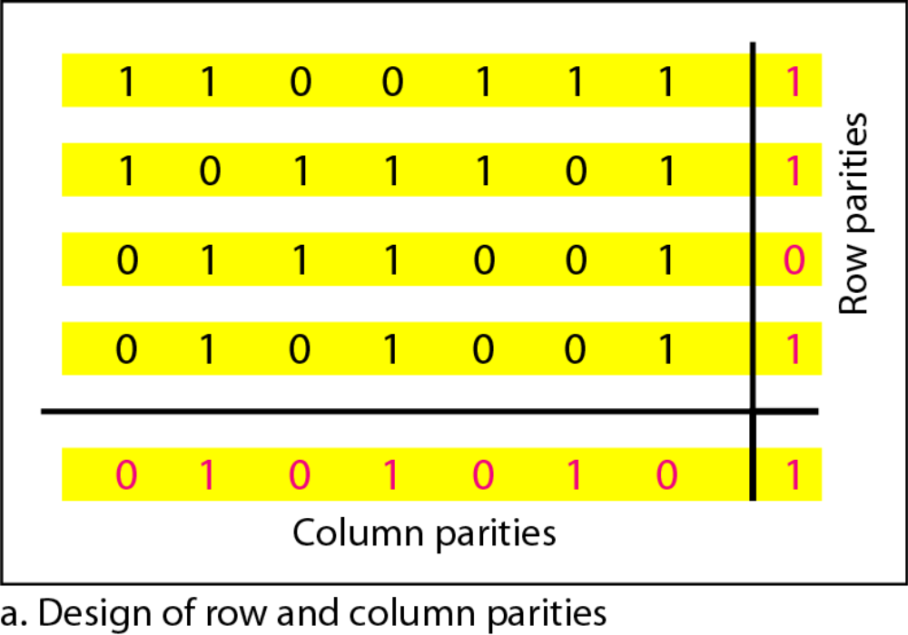
Two-dimensional parity-check code

Slide 46
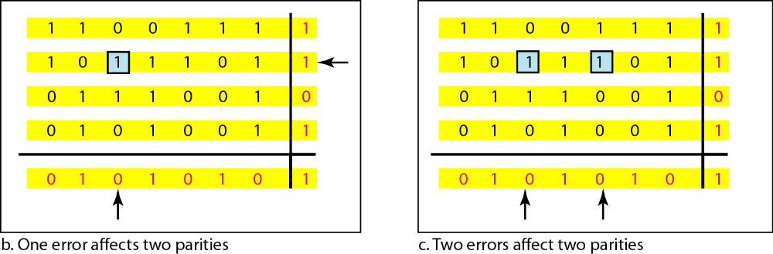

Slide 47
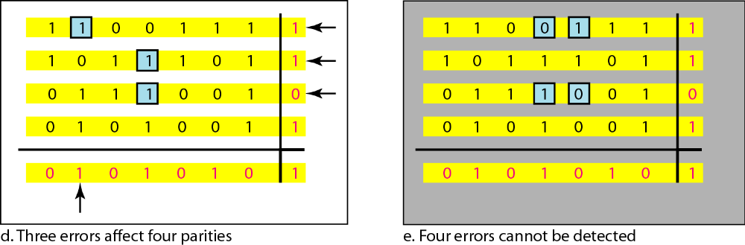

Slide 48
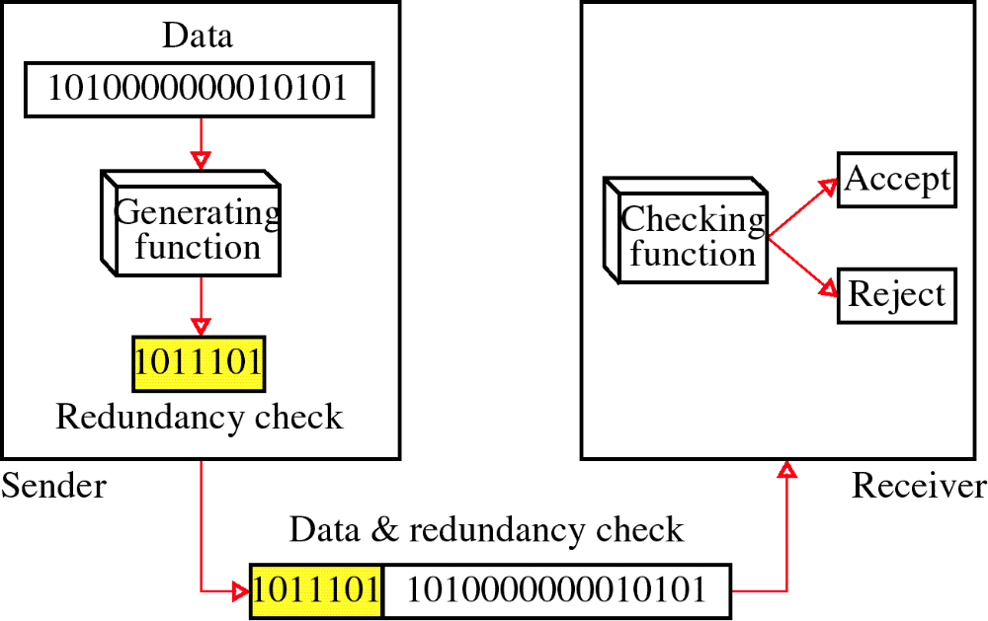
Redundancy

Slide 49
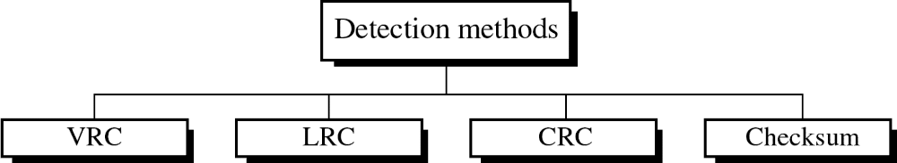
Four types of redundancy checks are used
in data communications

Slide 50
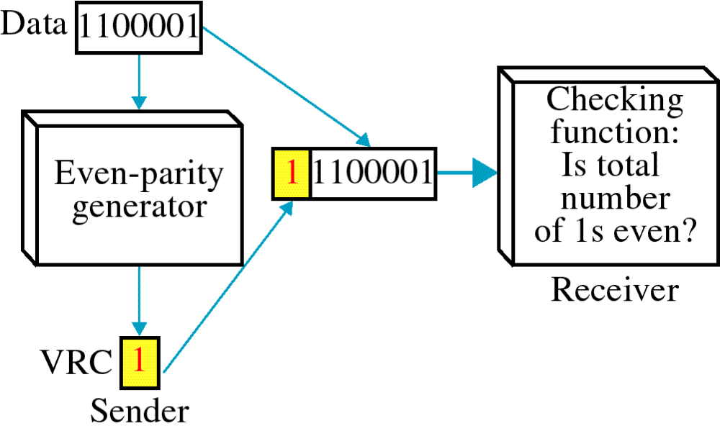
Vertical Redundancy Check
VRC

Slide 51
It can detect single bit error
It can detect burst errors only if the total number of errors is odd.

Slide 52
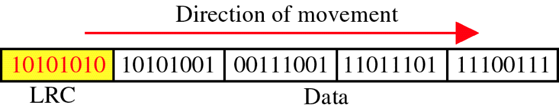
Longitudinal Redundancy Check
LRC

Slide 53
In longitudinal redundancy method, a BLOCK of bits are arranged in a table format (in rows and columns) and we will calculate the parity bit for each column separately. The set of these parity bits are also sent along with our original data bits.
Longitudinal redundancy check is a bit by bit parity computation, as we calculate the parity of each column individually.
This method can easily detect burst errors and single bit errors and it fails to detect the 2 bit errors occurred in same vertical slice.

Slide 54
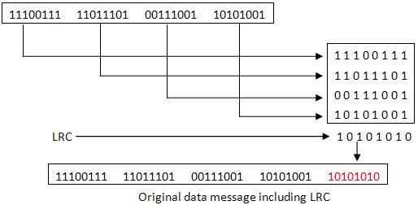

Slide 55
LRC increases the likelihood of detecting burst errors.
If two bits in one data units are damaged and two bits in exactly the same positions in another data unit are also damaged, the LRC checker will not detect an error.

Slide 56
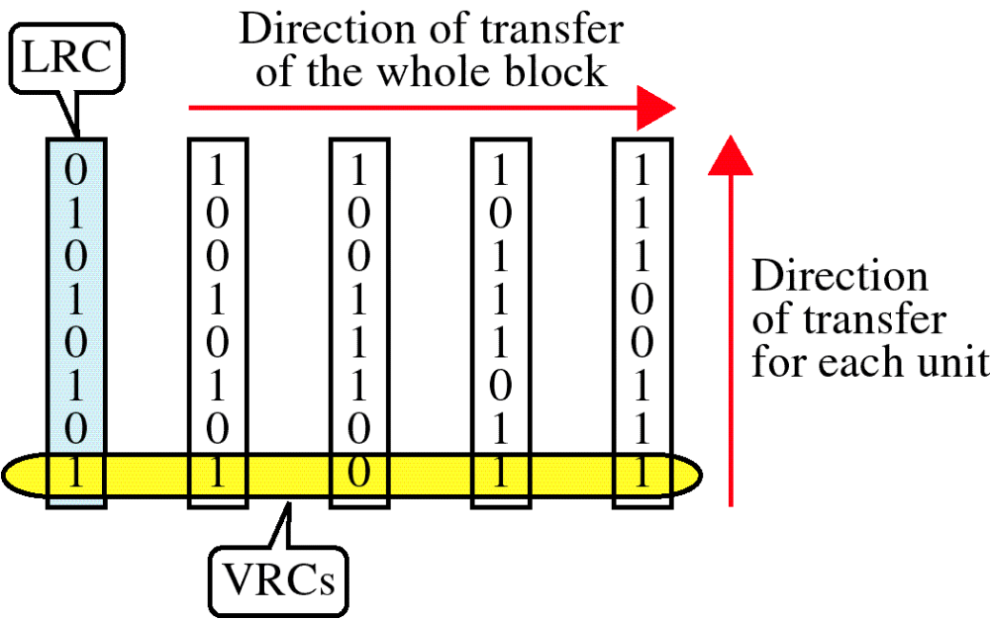
VRC and LRC

Slide 57
Cyclic redundancy check
The cyclic redundancy check considers a block of data as the coefficients to a polynomial and then divides by a fixed, predetermined polynomial.
The coefficients of the result of the division is taken as the redundant data bits, the CRC.
On reception, one can re-compute the CRC from the payload bits and compare this with the CRC that was received. A mismatch indicates that an error occurred.

Slide 58
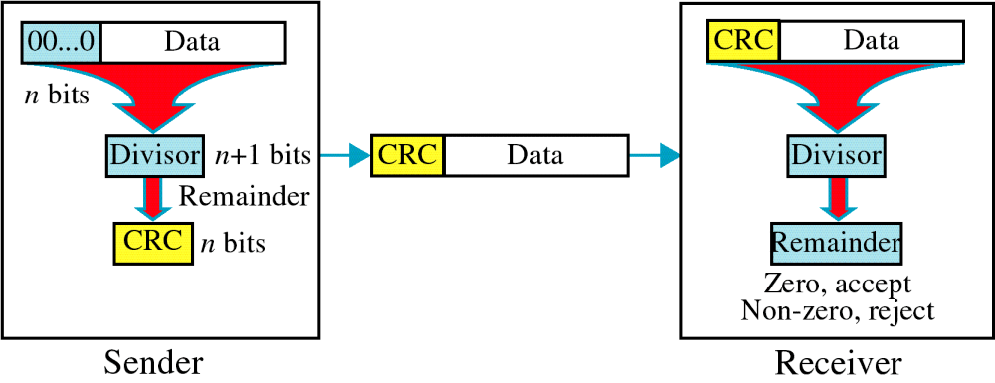
Cyclic Redundancy Check
CRC

Slide 59
Cyclic Redundancy Check
Given a k-bit frame or message, the transmitter generates an n-bit sequence, known as a frame check sequence (FCS), so that the resulting frame, consisting of (k+n) bits, is exactly divisible by some predetermined number.
The receiver then divides the incoming frame by the same number and, if there is no remainder, assumes that there was no error.

Slide 60
When the polynomial code method is employed, the sender and receiver must agree upon a generator polynomial, G(x), in advance. Both the high- and low order bits of the generator must be 1.
To compute the CRC for some frame with m bits corresponding to the polynomial M(x), the frame must be longer than the generator polynomial.
The idea is to append a CRC to the end of the frame in such a way that the polynomial represented by the checksummed frame is divisible by G(x).
When the receiver gets the checksummed frame, it tries dividing it by G(x). If there is a remainder, there has been a transmission error.

Slide 61
The algorithm for computing the CRC is as follows:
1. Let r be the degree of G(x). Append r zero bits to the low-order end of the frame so it now contains m + r bits and corresponds to the polynomial x rM(x).
2. Divide the bit string corresponding to G(x) into the bit string corresponding to x rM(x), using modulo 2 division.
3. Subtract the remainder (which is always r or fewer bits) from the bit
string corresponding to x rM(x) using modulo 2 subtraction.
The result is the checksummed frame to be transmitted.

Slide 62
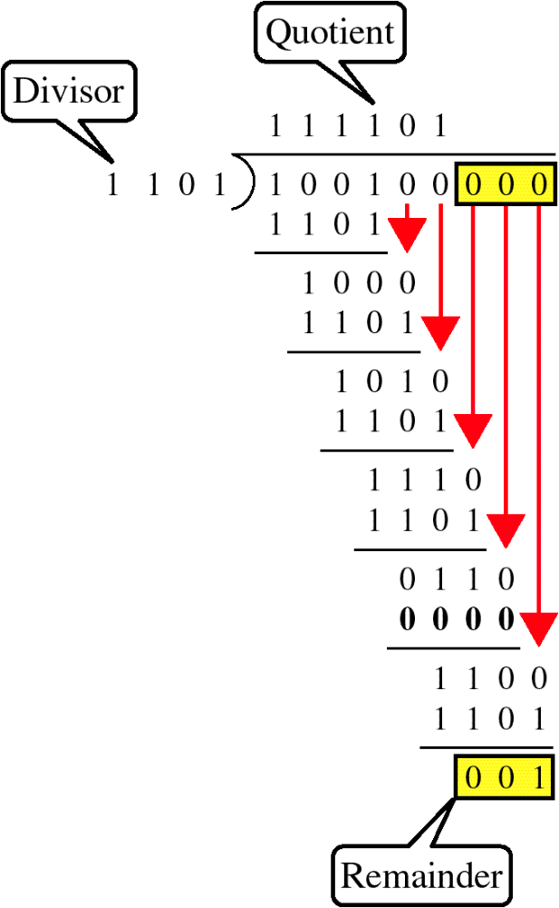
Binary Division

Slide 63
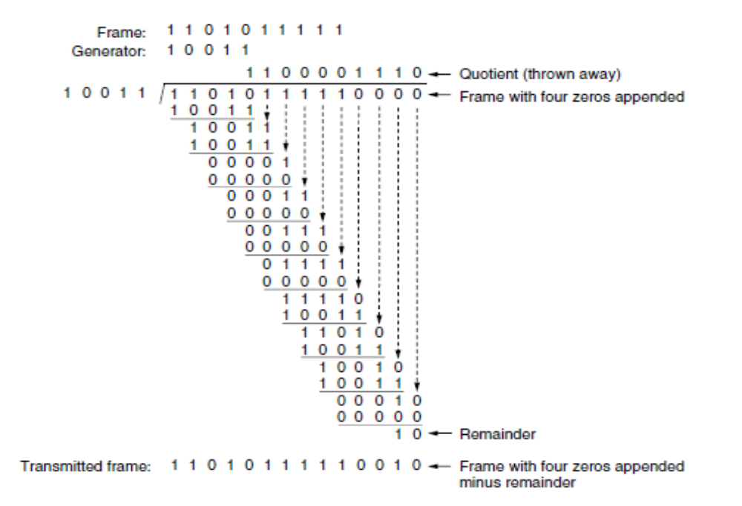

Slide 64
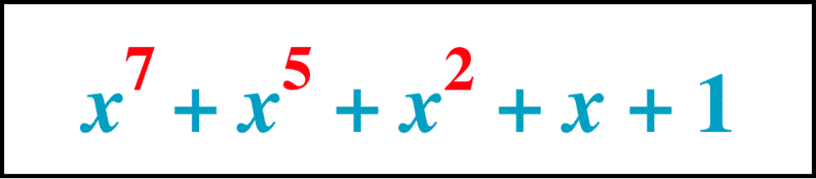
Polynomial

Slide 65
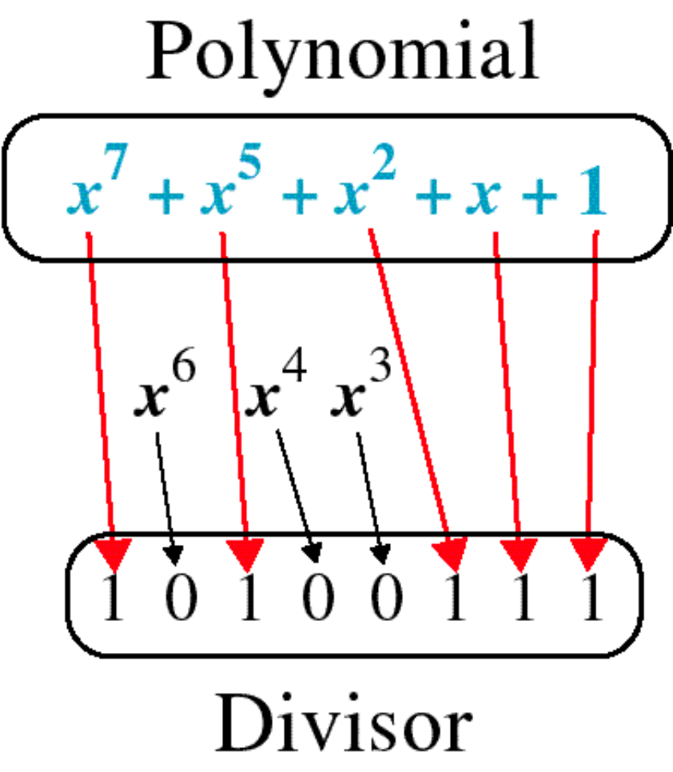
Polynomial and Divisor

Slide 66
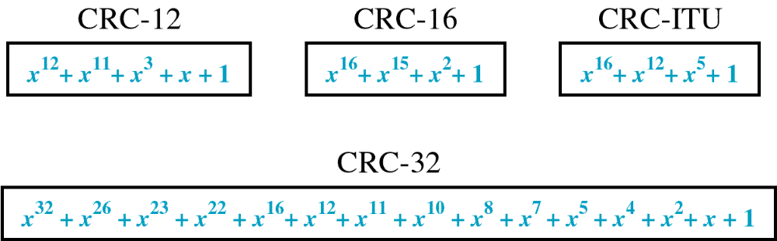
Standard Polynomials

Slide 67
Checksum
The checksum, is closely related to groups of parity bits.
The word ‘‘checksum’’ is often used to mean a group of check bits associated with a message, regardless of how they are calculated. A group of parity bits is one example of a checksum.
However, there are other, stronger checksums based on a running sum of the data bits of the message. The checksum is usually placed at the end of the message, as the complement of the sum function.
This way, errors may be detected by summing the entire received codeword, both data bits and checksum. If the result comes out to be zero, no error has been detected.

Slide 68
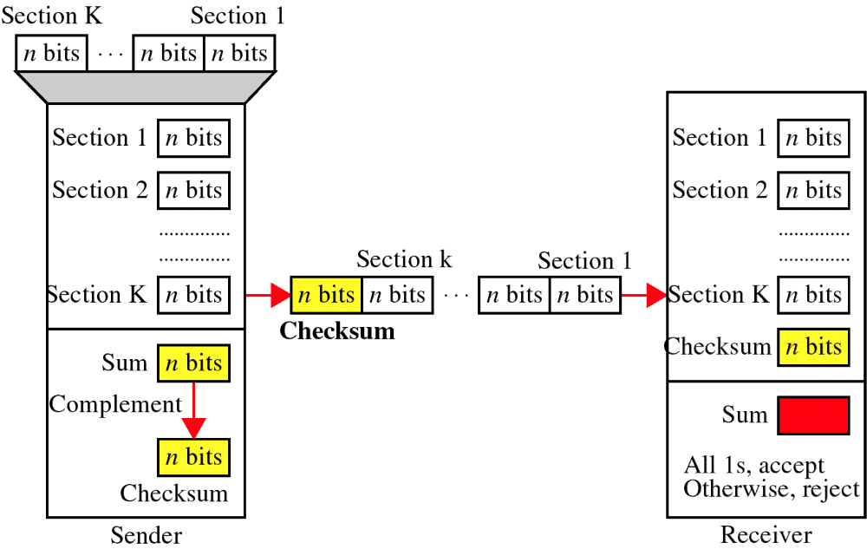
Checksum

Slide 69
A checksum of a message is an arithmetic sum of message code words of a certain word length, for example byte values, and their carry value.
The sum is negated by means of ones-complement, and stored or transferred as an extra code word extending the message.
On the receiver side, a new checksum may be calculated from the extended message. If the new checksum is not 0, an error has been detected.

Slide 70
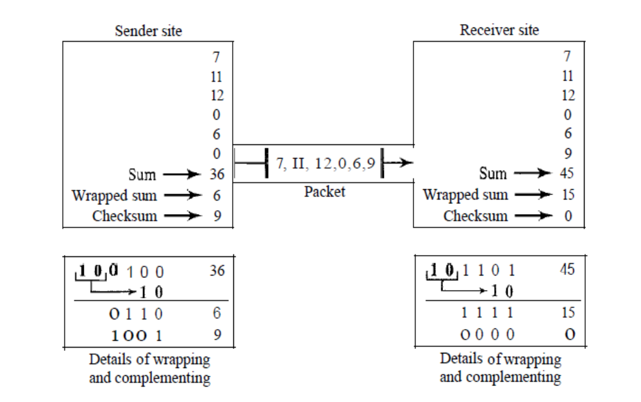

Slide 71
The sender initializes the checksum to 0 and adds all data items and the checksum (the checksum is considered as one data item).
The result is 36. However, 36 cannot be expressed in 4bits.
The extra two bits are wrapped and added with the sum to create the wrapped sum value 6.
The sum is then complemented, resulting in the checksum value 9 (15−6=9).
The sender now sends six data items to the receiver including the checksum 9.

Slide 72
The receiver follows the same procedure as the sender.
It adds all data items (including the checksum); the result is 45.
The sum is wrapped and becomes 15. The wrapped sum is complemented and becomes 0.
Since the value of the checksum is 0, this means that the data is not corrupted.
The receiver drops the checksum and keeps the other data items.
If the checksum is not zero, the entire packet is dropped.

Slide 73
The checksum detects all errors involving an odd number of bits.
It detects most errors involving an even number of bits.
If one or more bits of a segment are damaged and the corresponding bit or bits of opposite value in a second segment are also damaged, the sums of those columns will not change and the receiver will not detect a problem.

Slide 74
Internet Checksum
Traditionally, the Internet has been using a 16-bit checksum. The sender calculates the checksum by following these steps.
Sender site:
1.The message is divided into 16-bit words.
2.The value of the checksum word is set to 0.
3.All words including the checksum are added using one’s complement addition.
4.The sum is complemented and becomes the checksum.
5.The checksum is sent with the data.

Slide 75
Receiver site:
1.The message (including checksum) is divided into 16-bit words.
2.All words are added using one’s complement addition.
3.The sum is complemented and becomes the new checksum.
4.If the value of checksum is 0, the message is accepted; otherwise, it is rejected.

